Slide 1
Diffusion models for generating background events
Korl Železnikar, 10. 12. 2025

Slide 2
Introduction
Promising frameworks: standard stohastic DDPM
Data is transformed using a rank transform, with an inverf transfromation to a standard normal distribution – the models lear the deviations, preconditioning helps (kind of)
Score networks: ODE sampling = less steps, faster but lowers samples‘ variance – not good for sampling
RESAMPLE in PONOVI C2ST TESTE ZA VP, VE modele!!!!!!

Slide 3
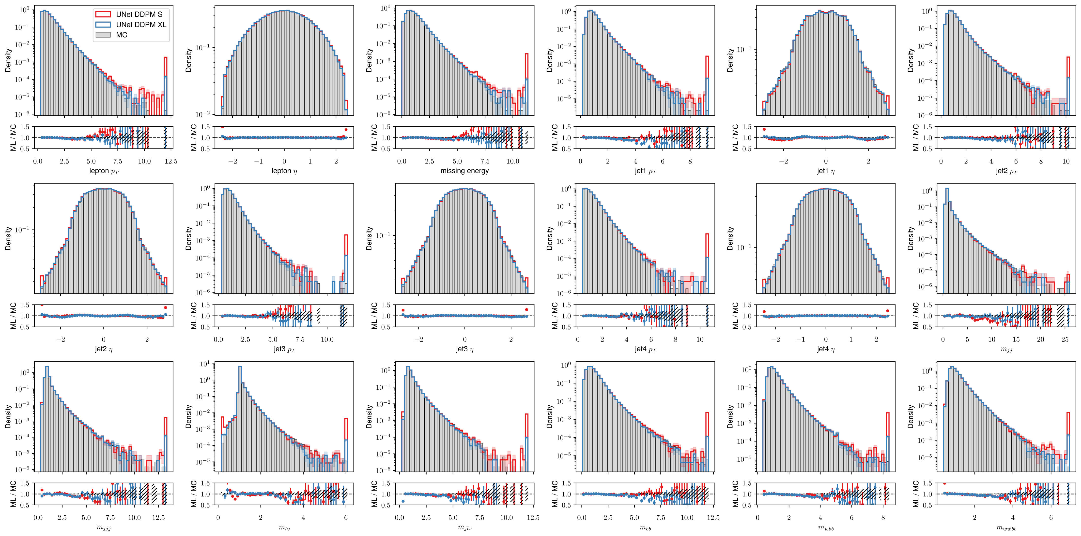




DDPM sampling
After sampling the transformed data, all the outliers are mapped to tails

Slide 4
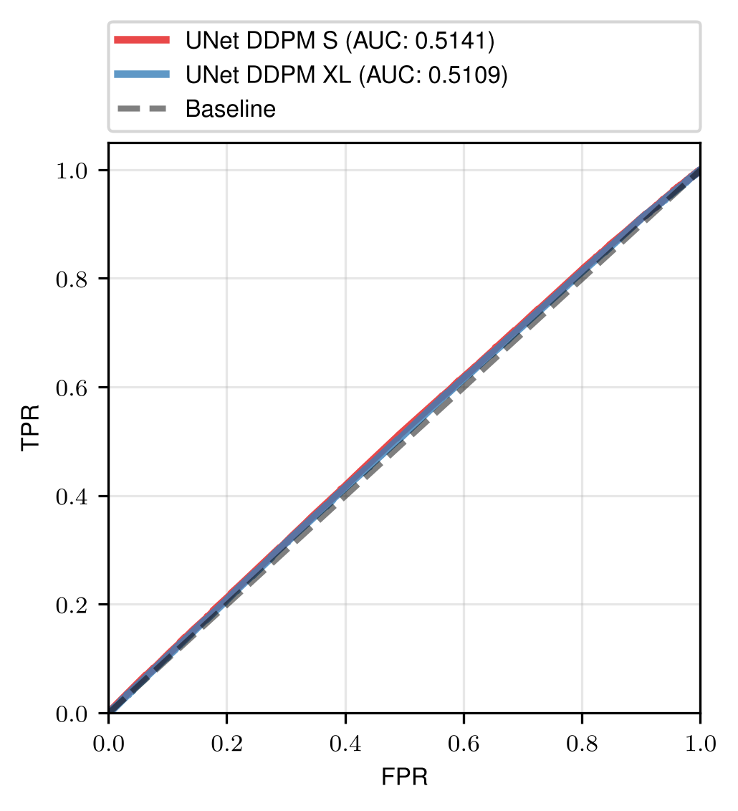
C2ST test
Tested for 10^6 generated samples

Slide 5
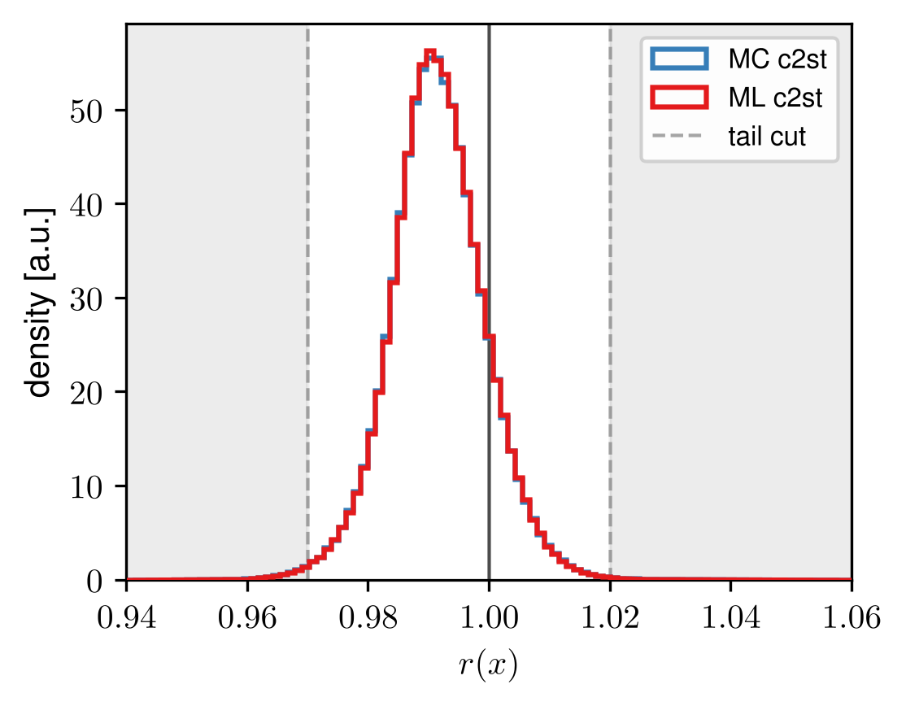
Ratio test and tail cuts

Slide 6
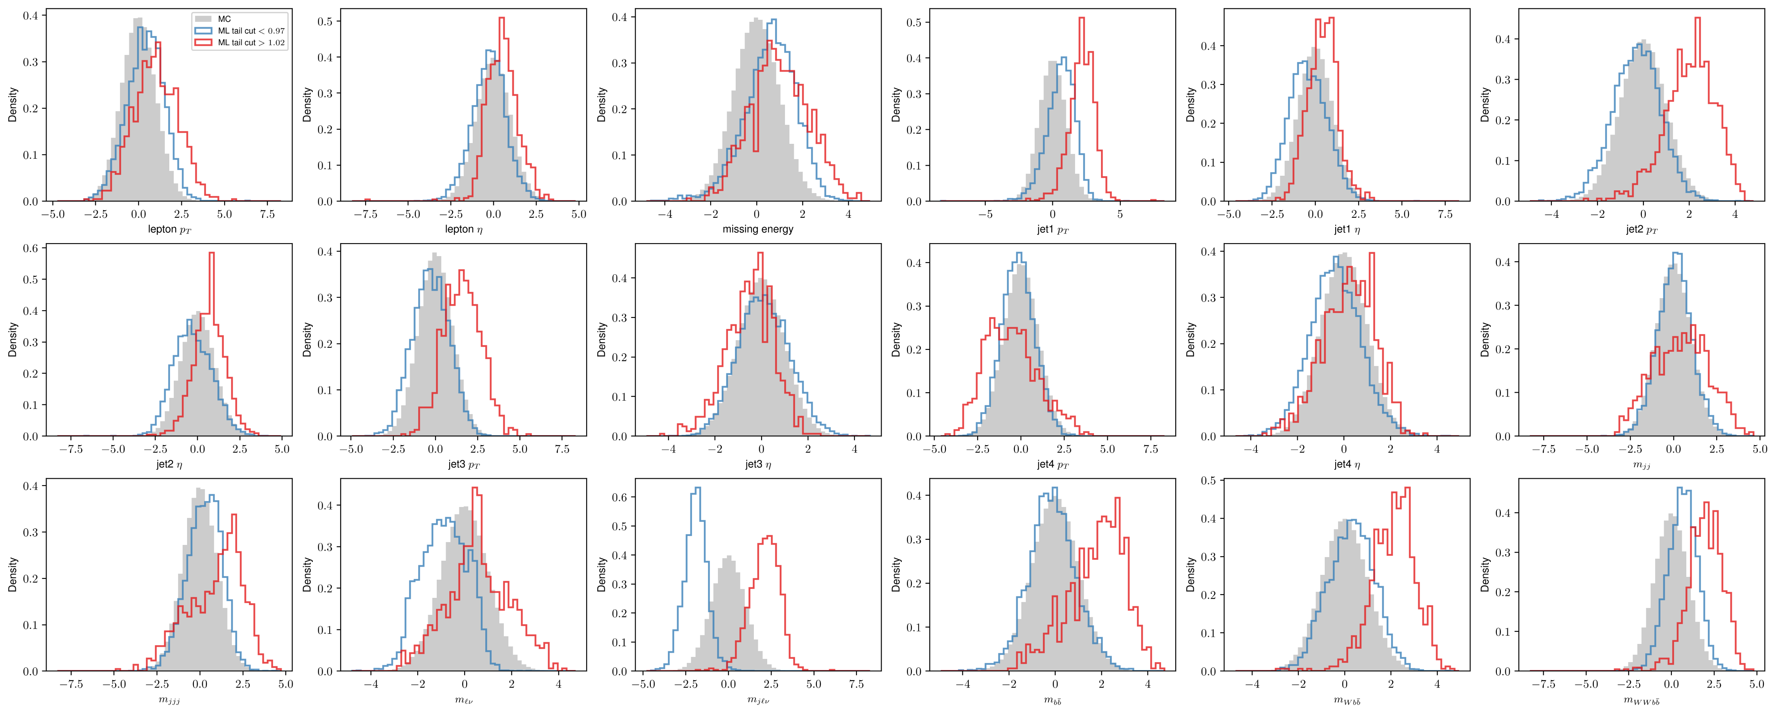
Distributions after the cut

Slide 7
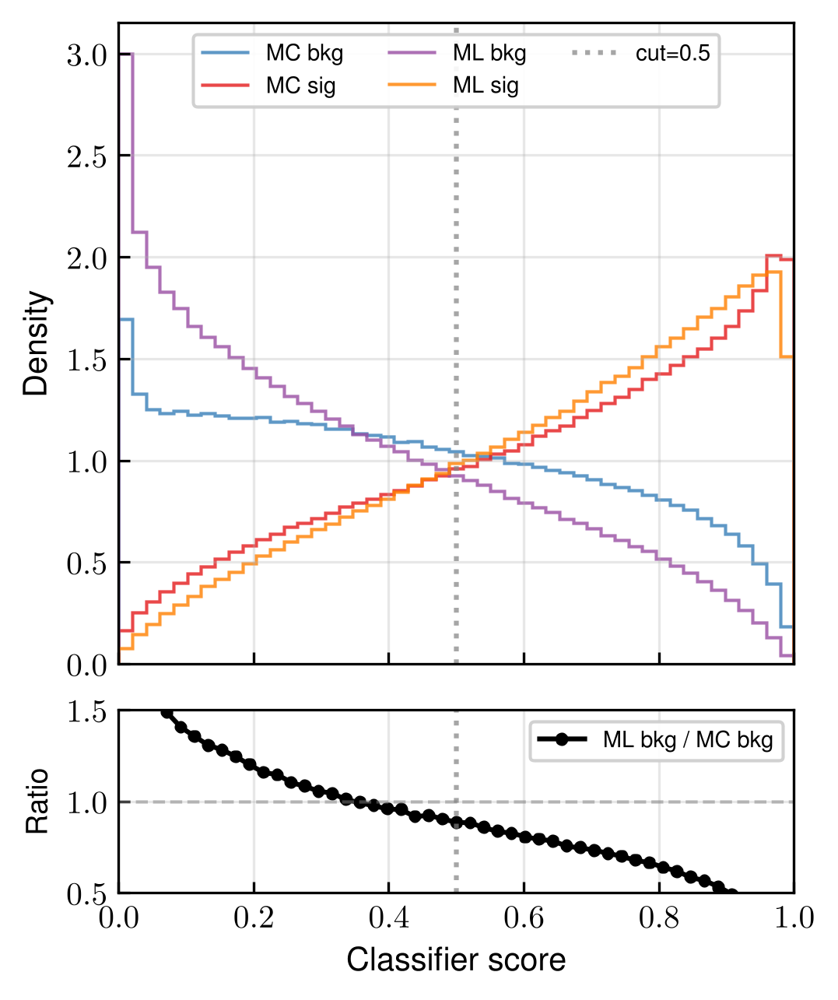
Sig.-Bkg. Ratios for DDPM

Slide 8
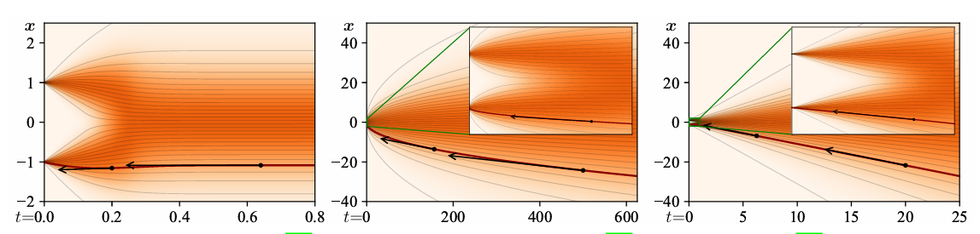
Score based frameworks
Variance preserving – continuous version of DDPM, stable
Variance exploding – nonlinear at the end steps
EDM – straightest trajectories = better sampling?
VP
VE
DDIM/EDM

Slide 9
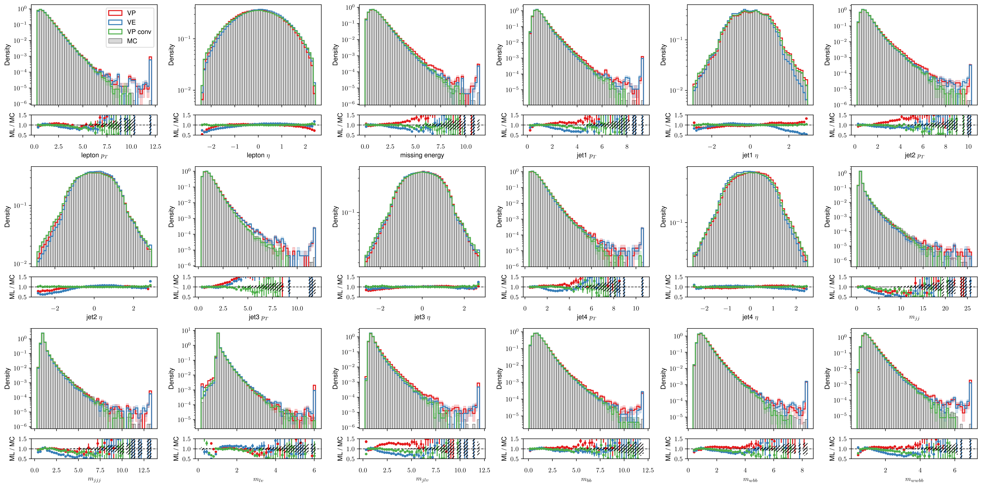
VP, VE, VP conv samples

Slide 10
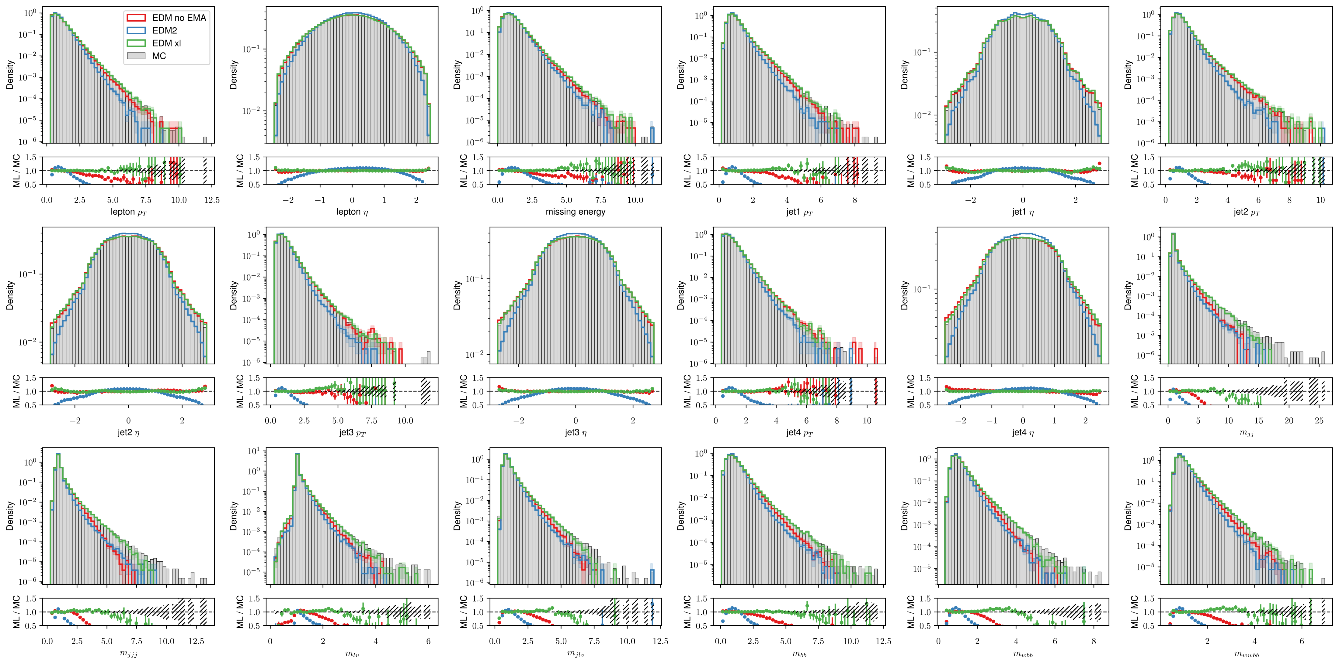
EDM, EDM2 samples
Variance undershooting problems in high level features

Slide 11
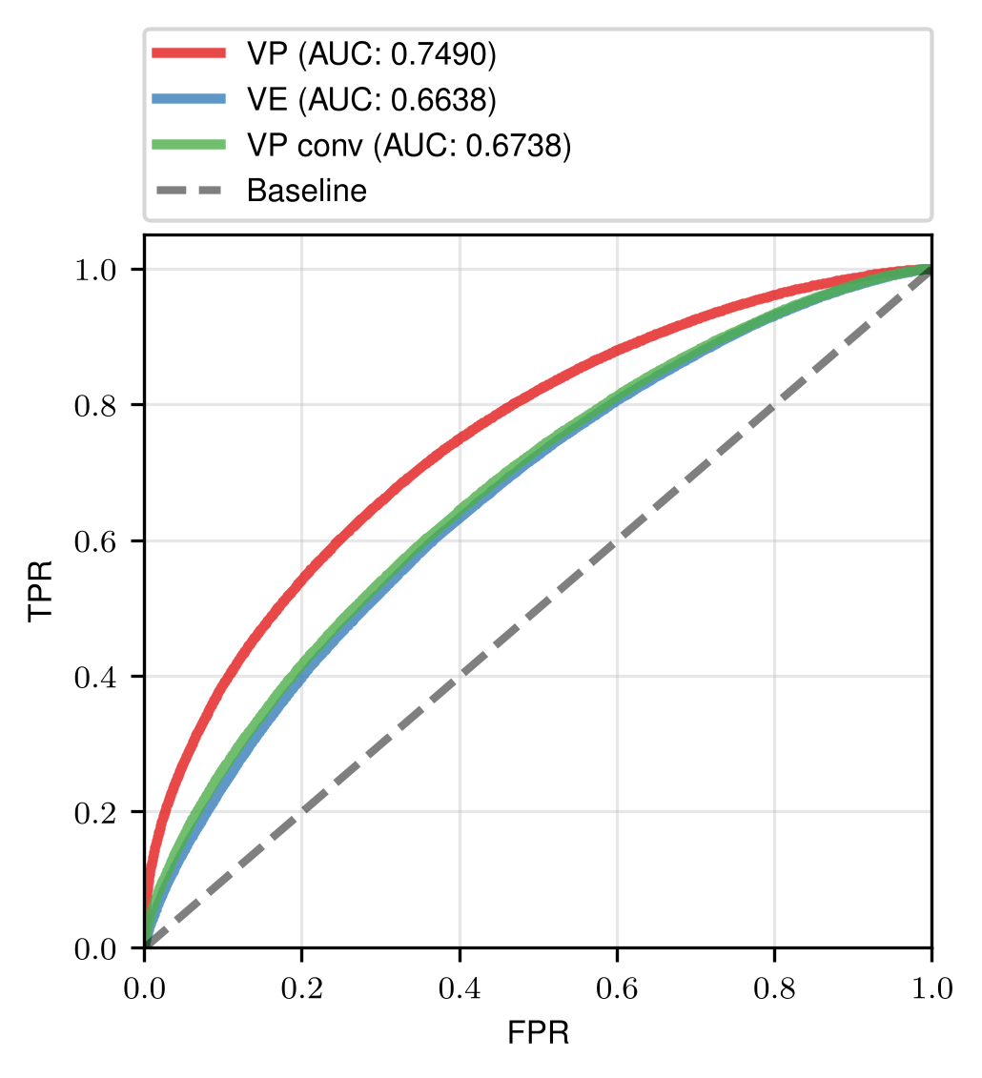
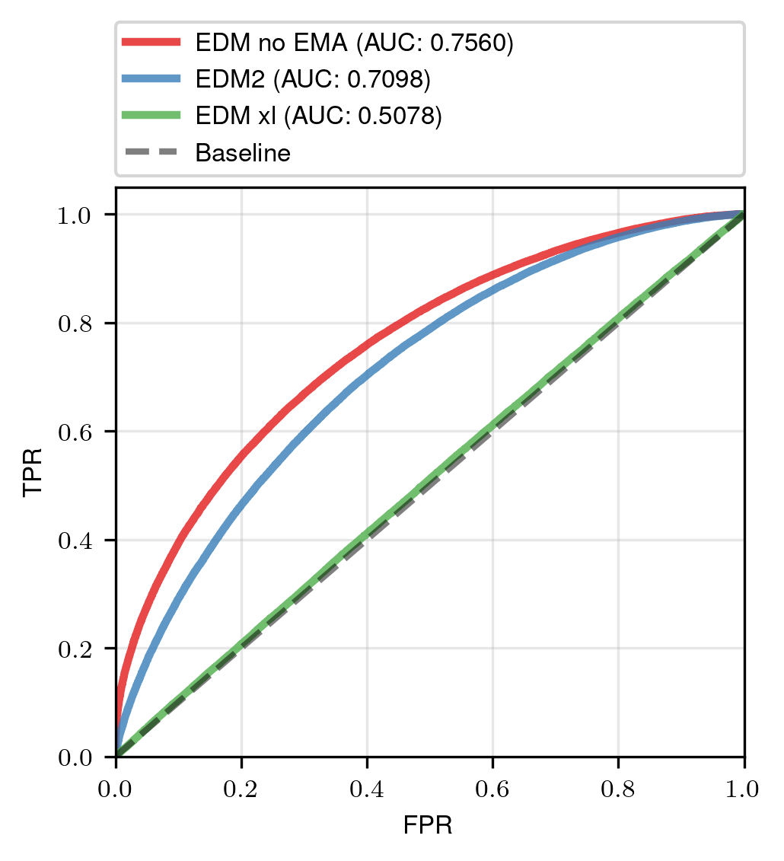

Slide 12
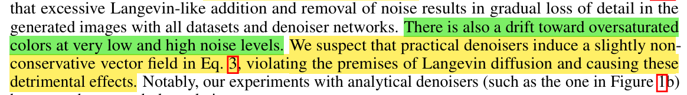
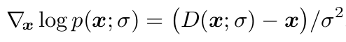




Problems with training
These have been „optimized“, but variance still too low after training

Slide 13
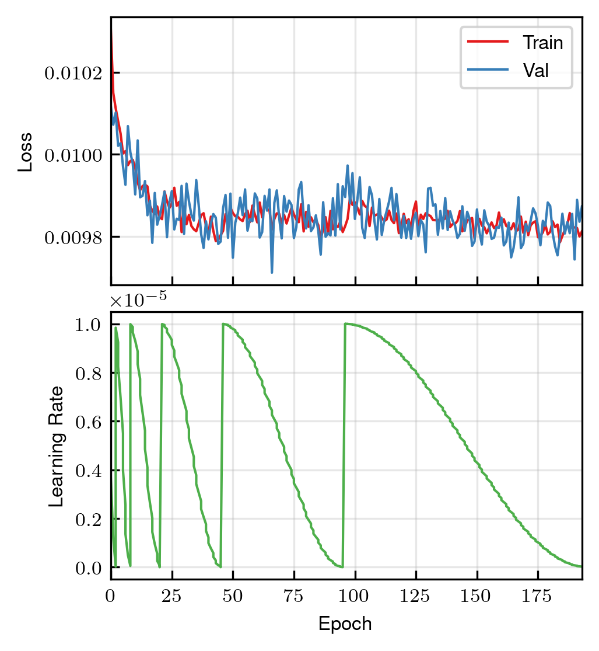


EDM training
Starting loss small, then it barely improves
Really noisy even at small learning rates

Slide 14
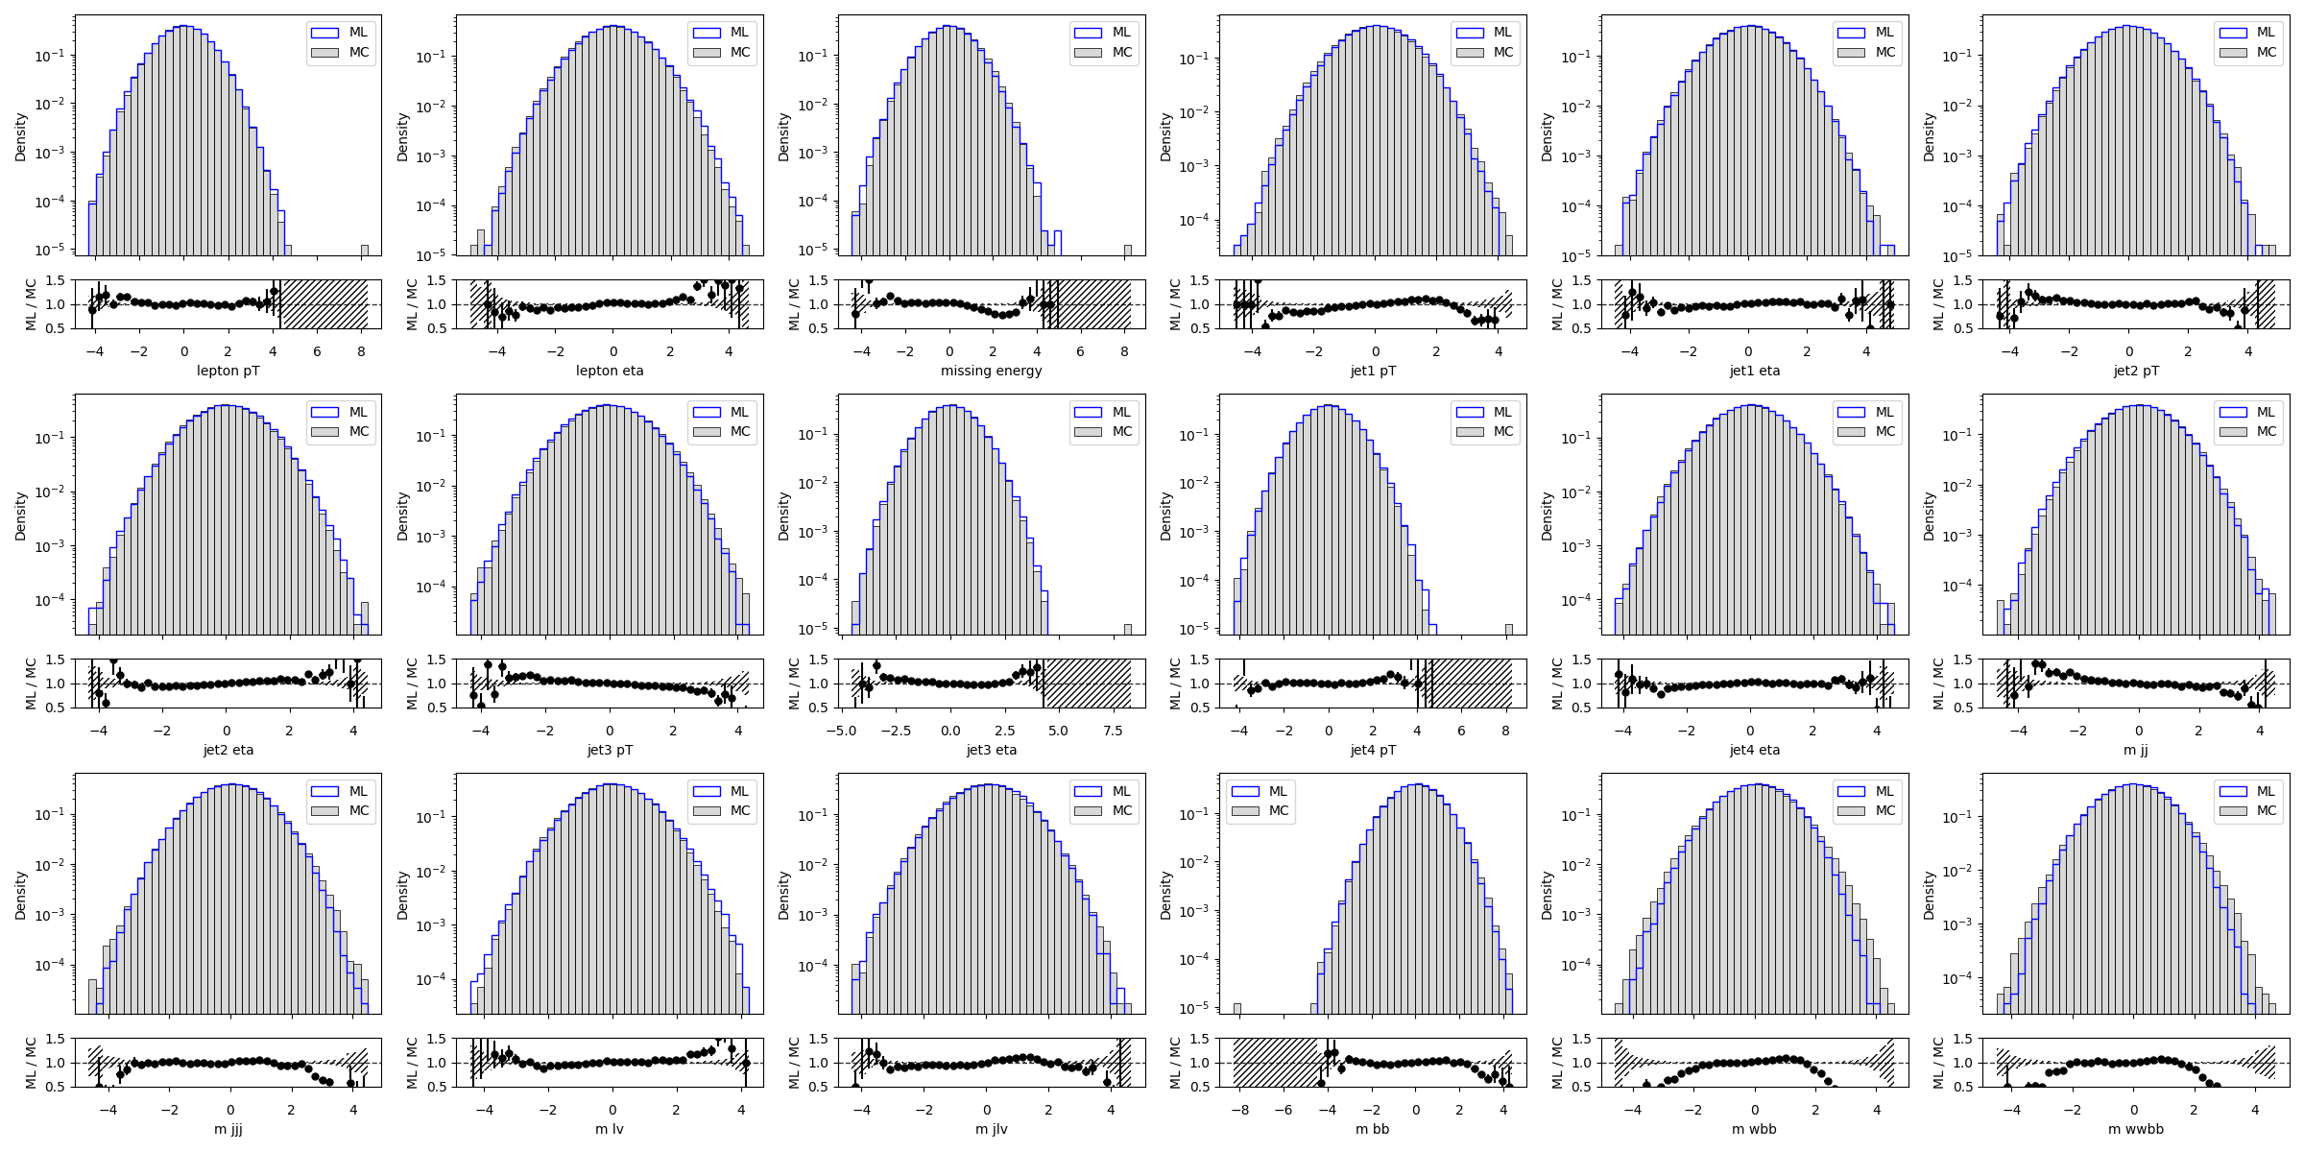
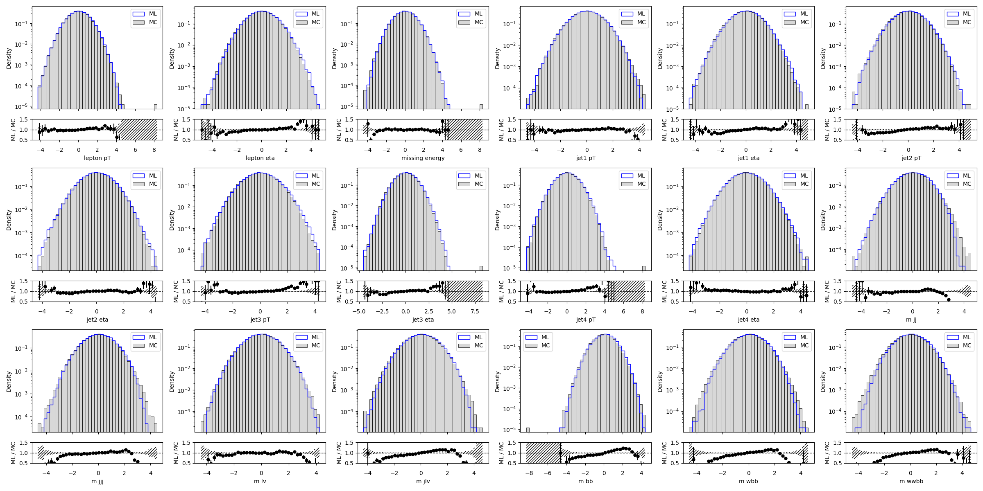
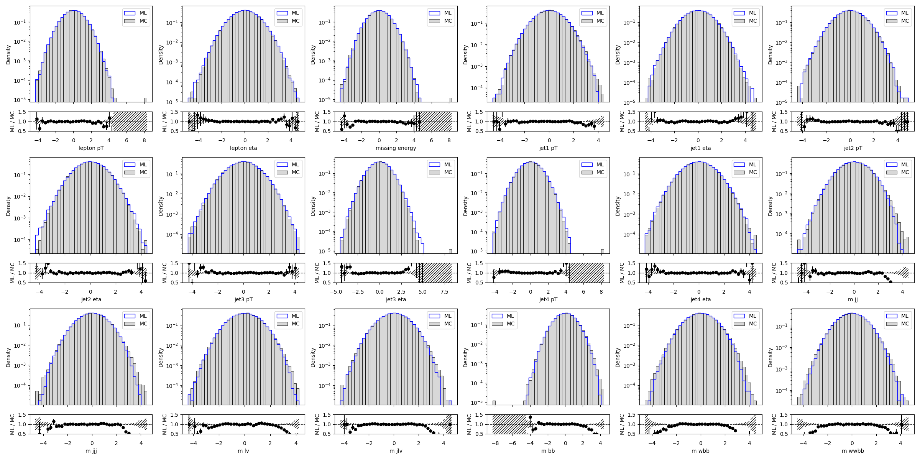
Training sampled snapshots for EDM
Epoch 192/196
Epoch 93/196
Epoch 0/196

Slide 15
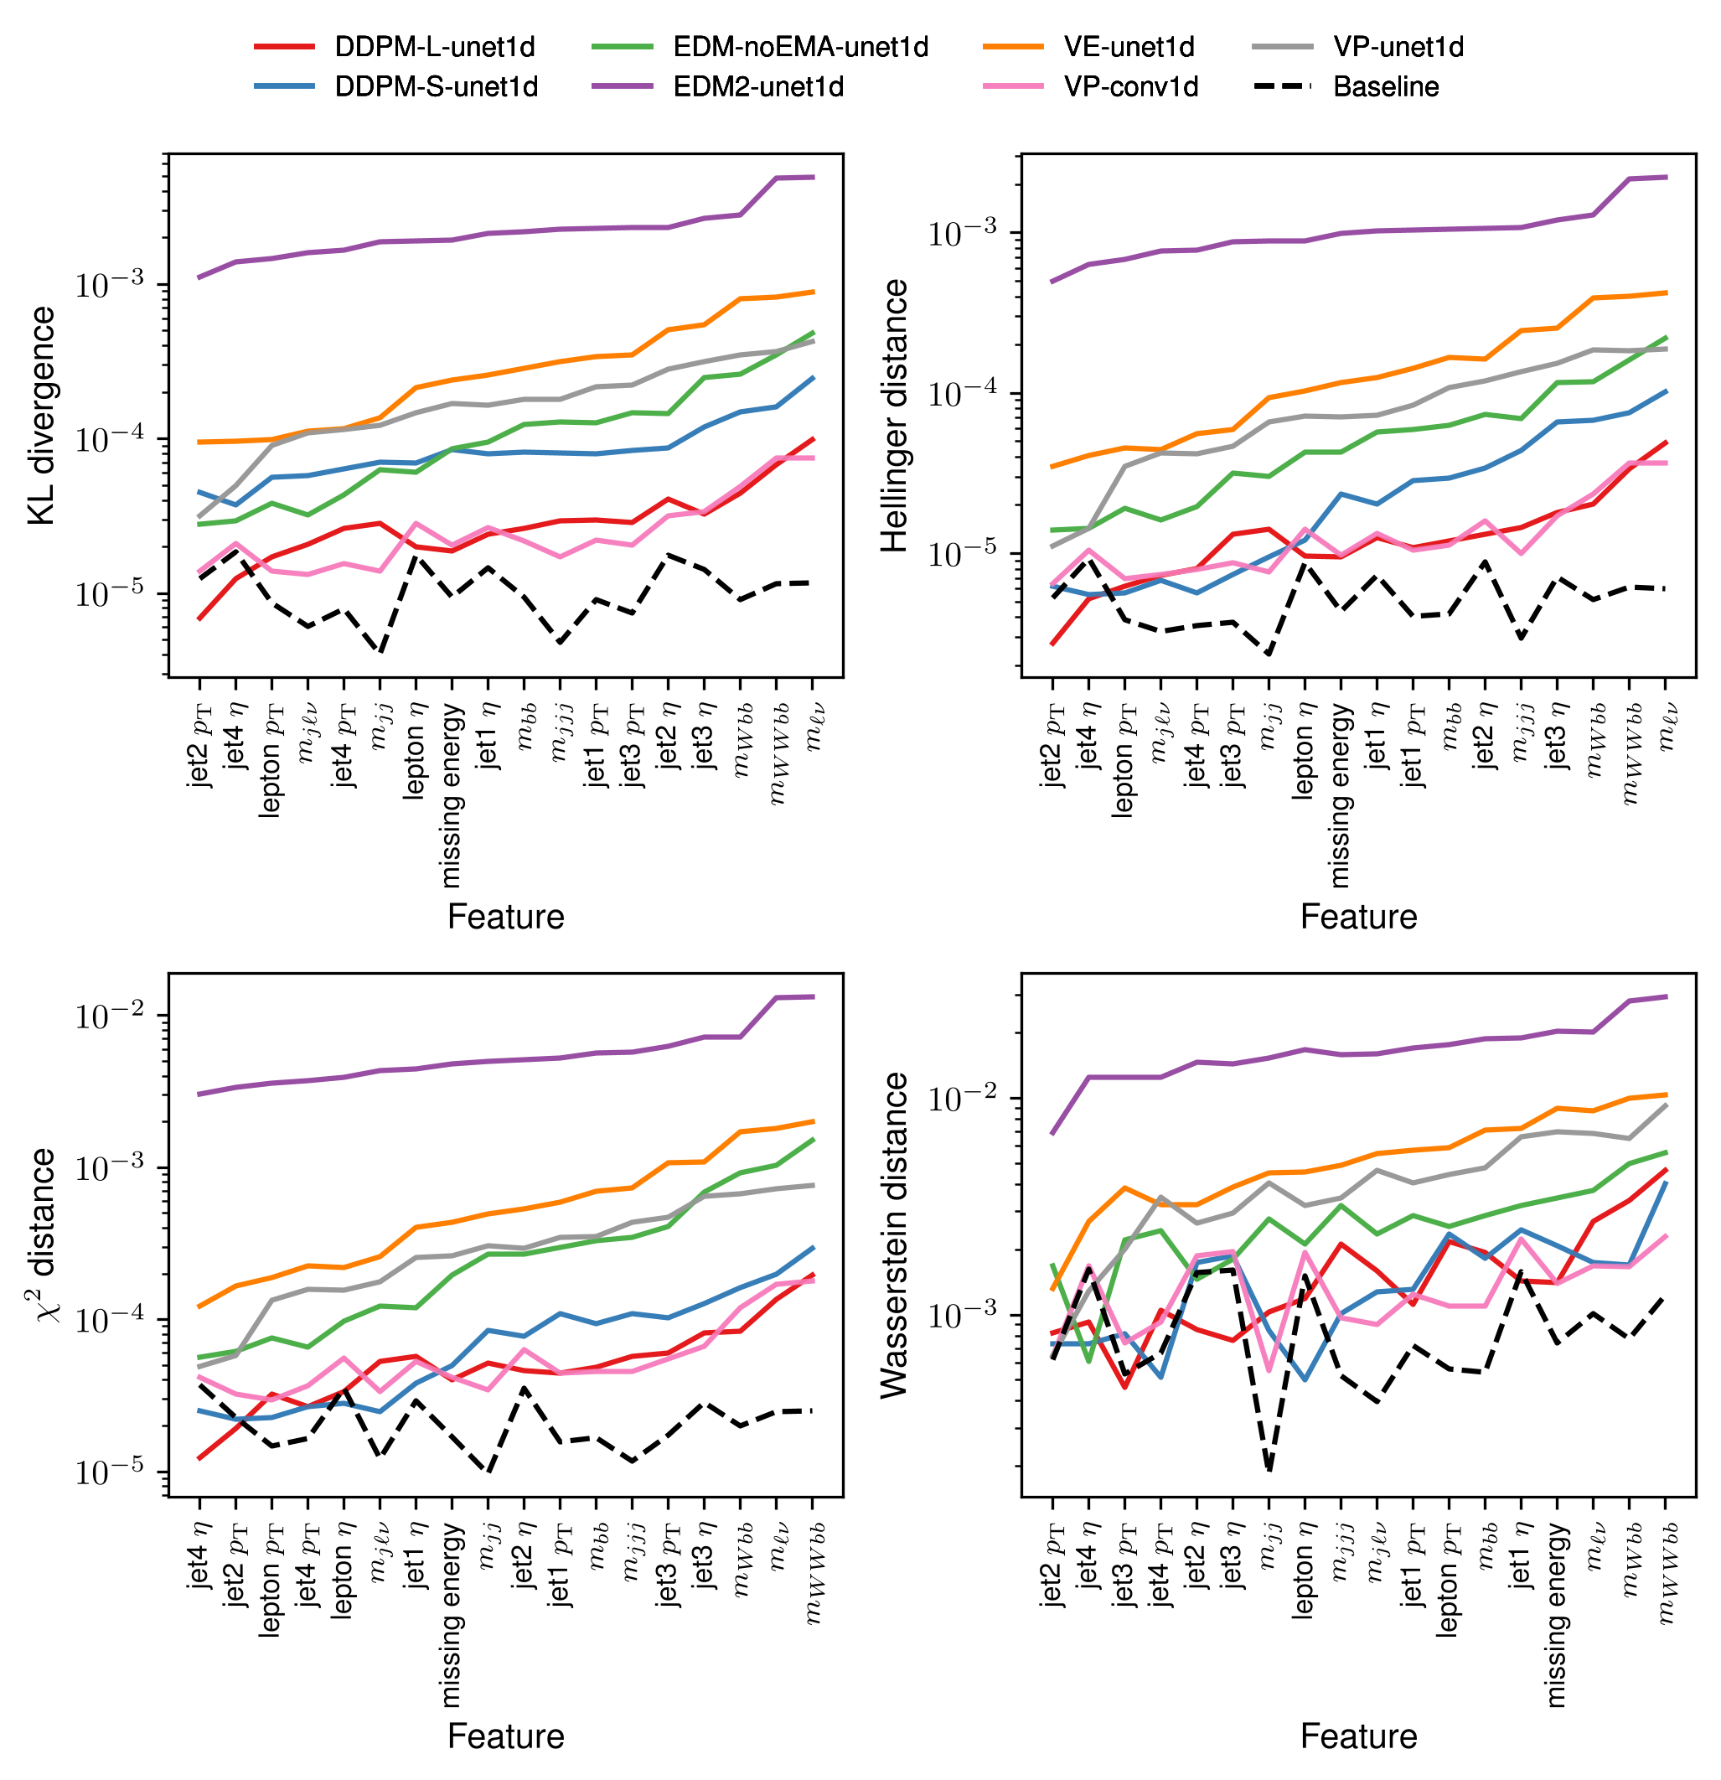
Model distances

Slide 16
Todo list
Improve the EDM framework – reweighing data?
New/other architectures – small data dim = problems
Consistency models for fast sampling
Training parameter and sampling ODE solver parameter optimization
Power function EMA parameter optimization/quality quantification
Autoguidance?
DDPM – better preconditioning?

Slide 17
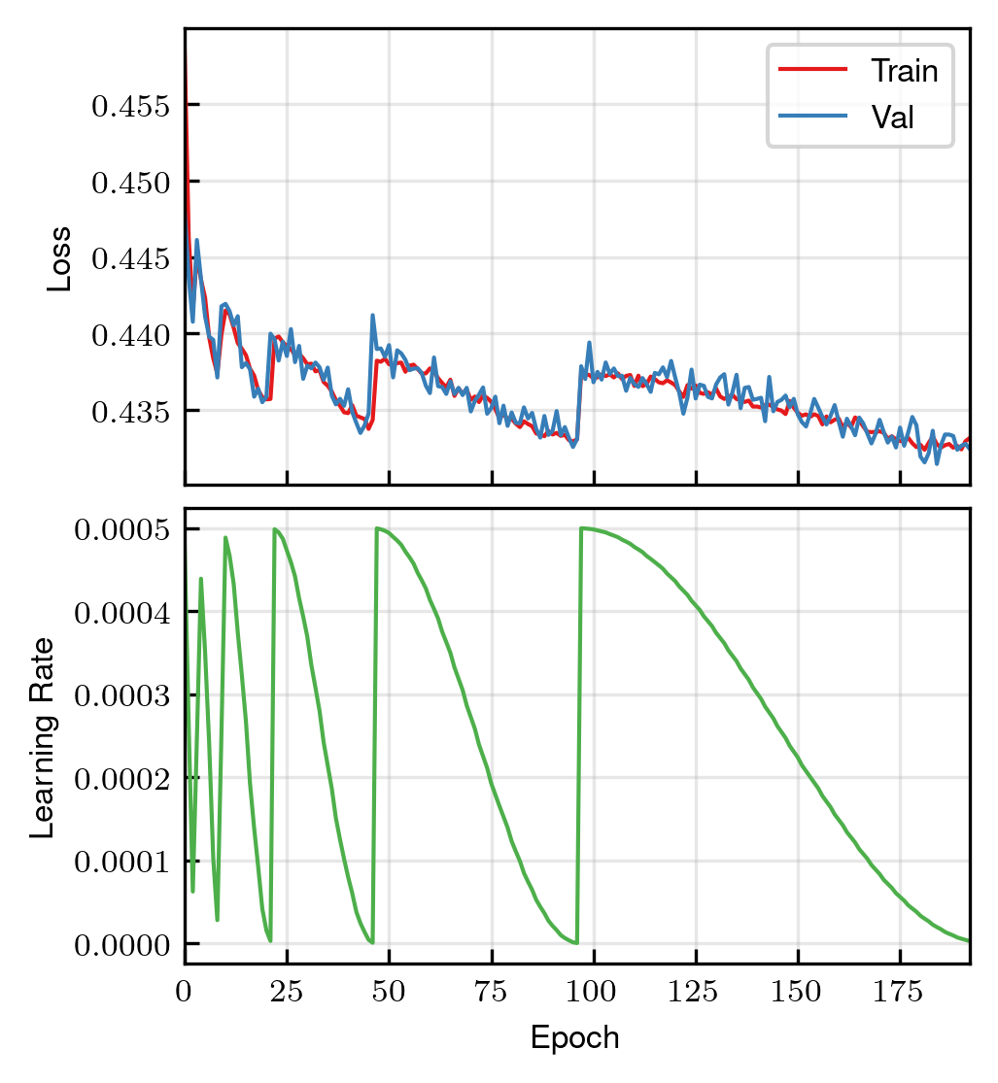
DDPM training

Slide 18
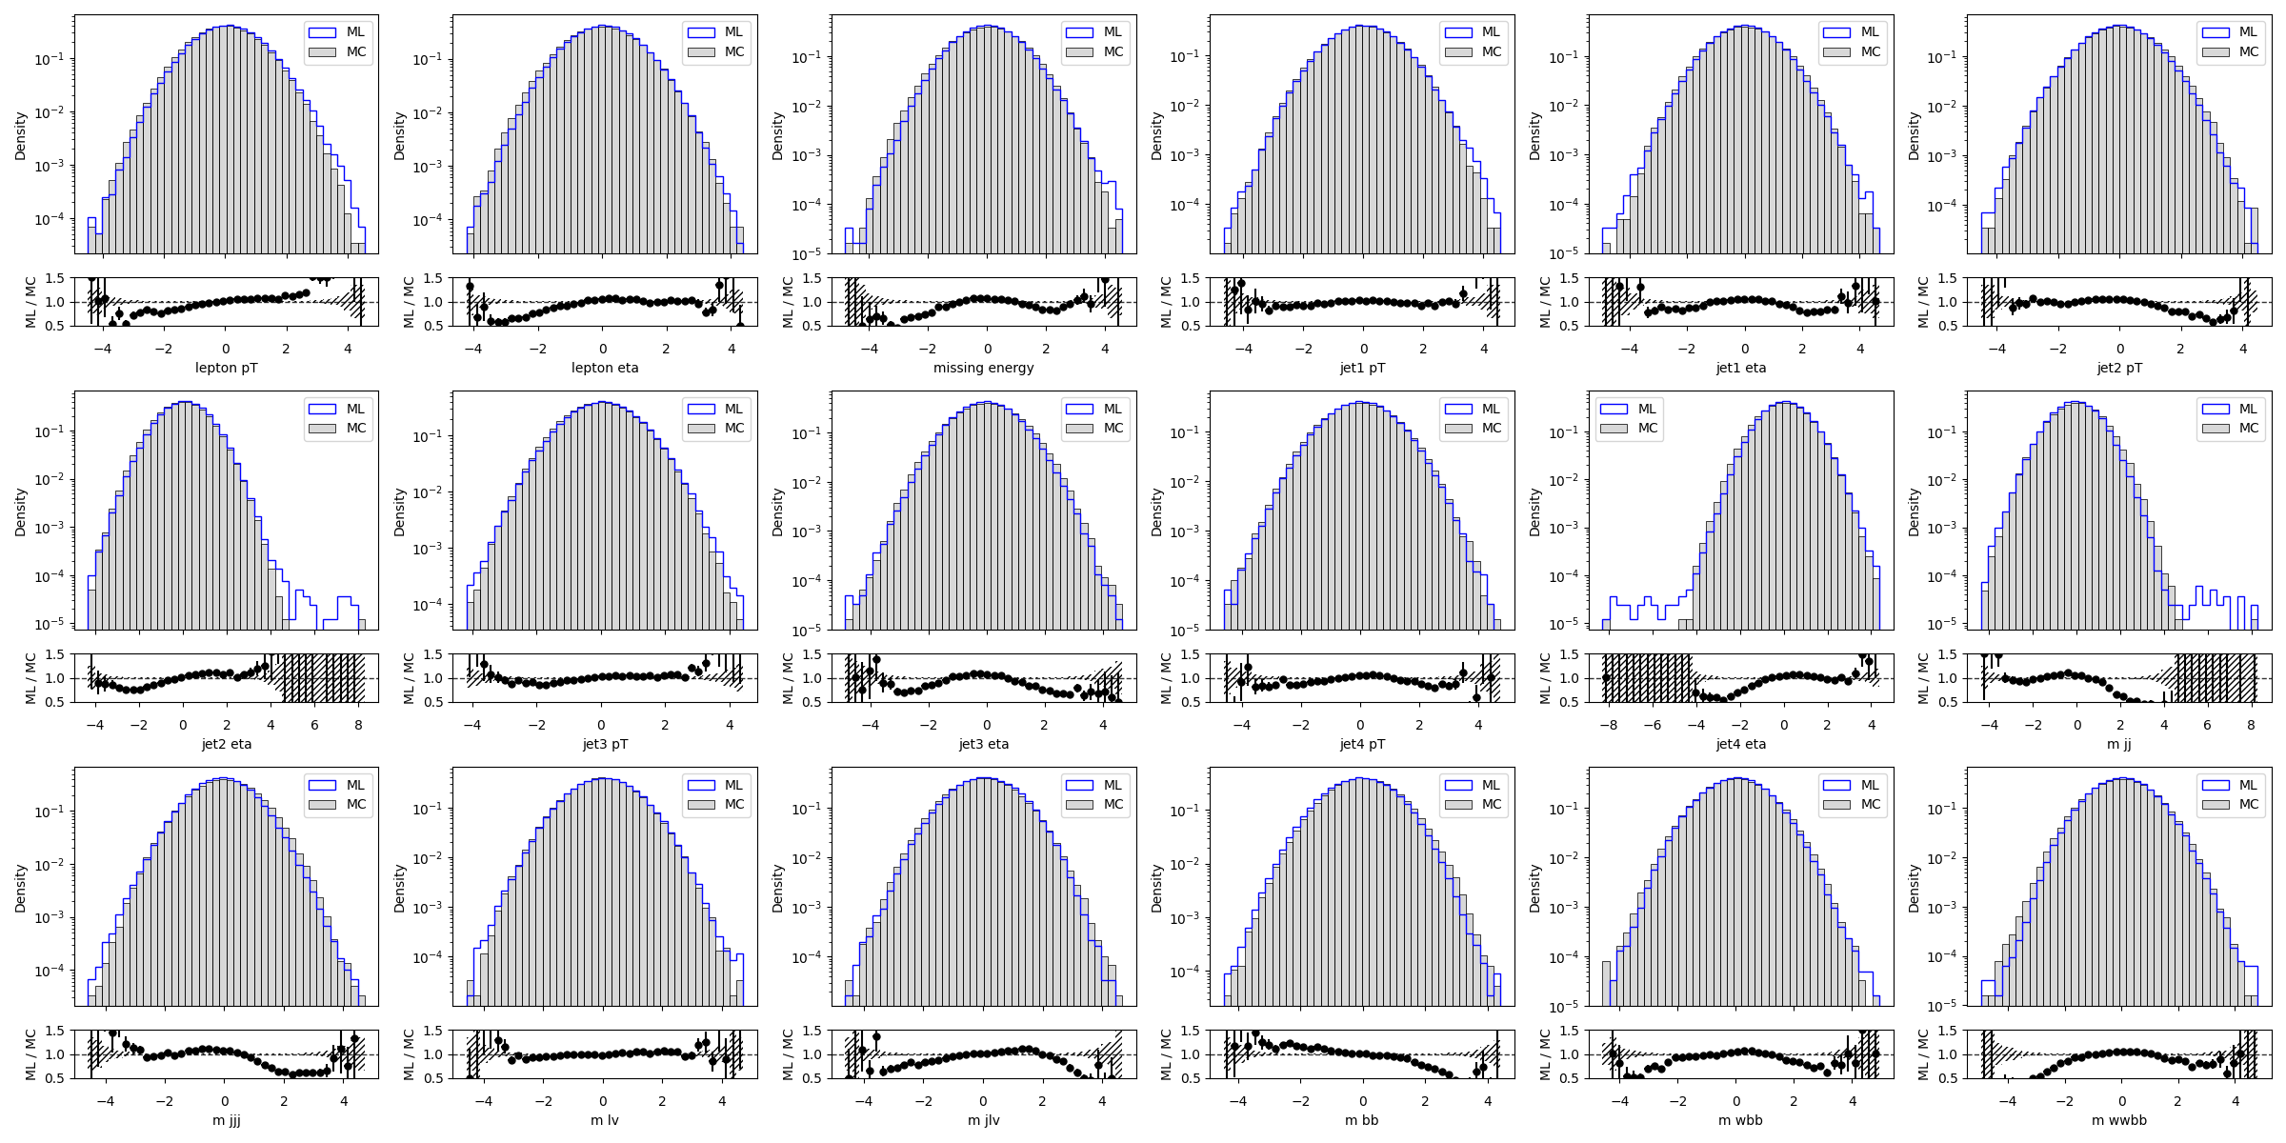
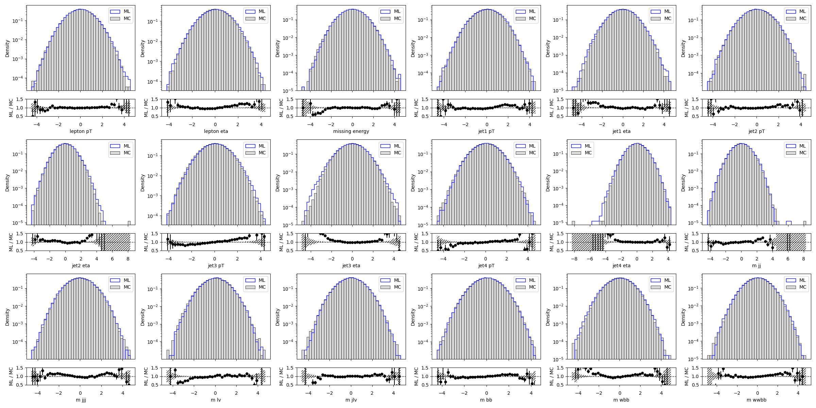
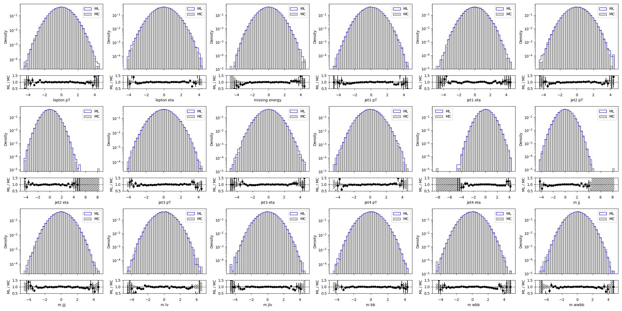
Training sampled snapshots for DDPM
Epoch 114/190
Epoch 190/196
Epoch 0/190

Slide 19
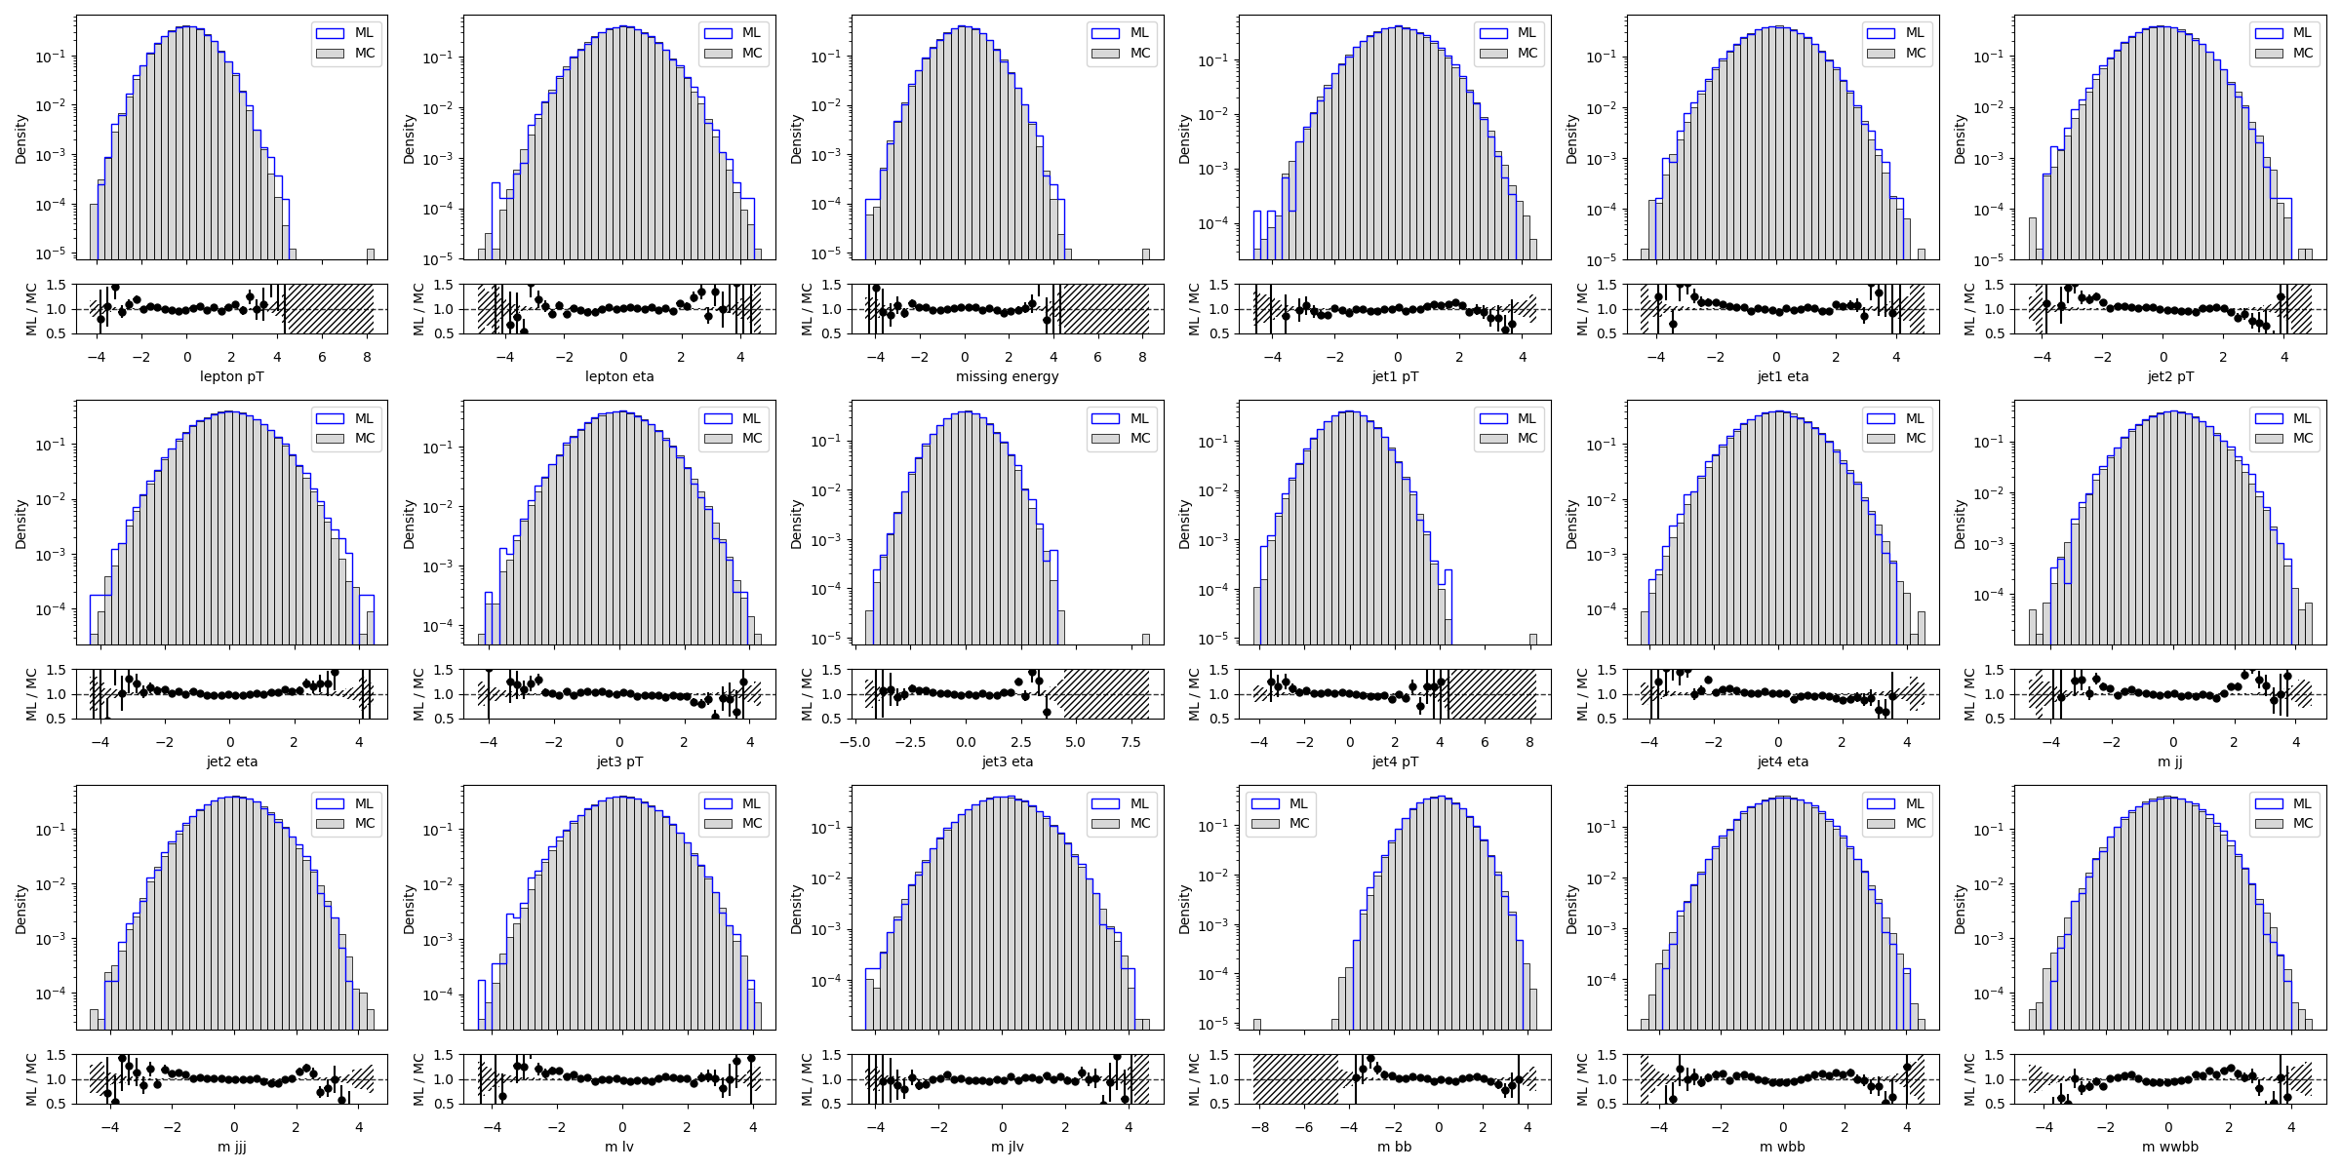
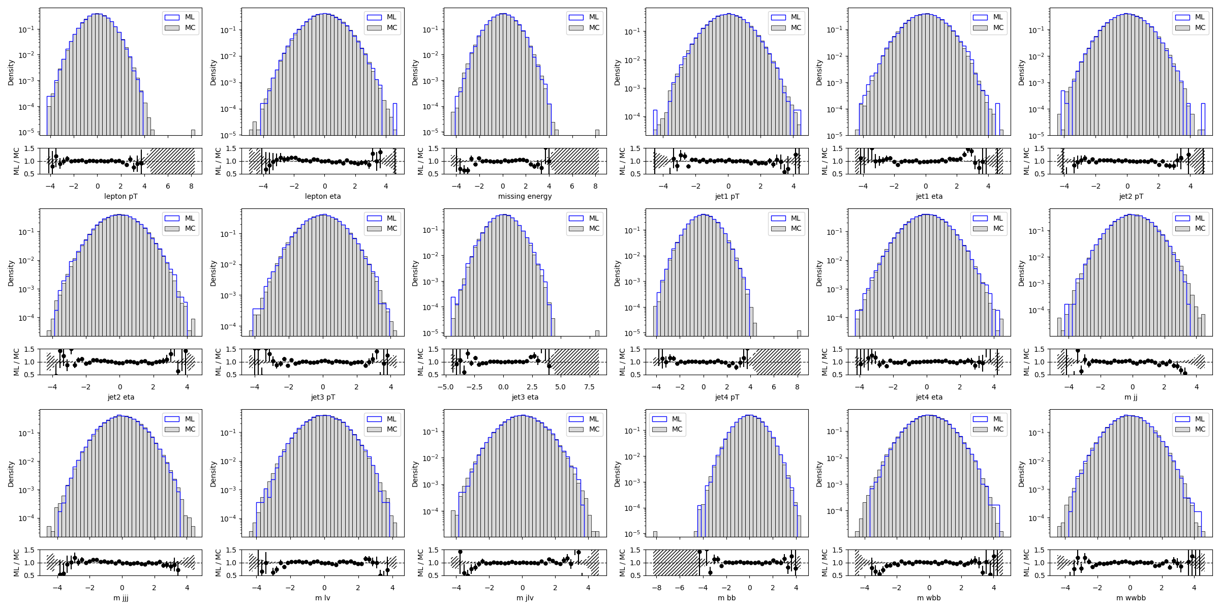
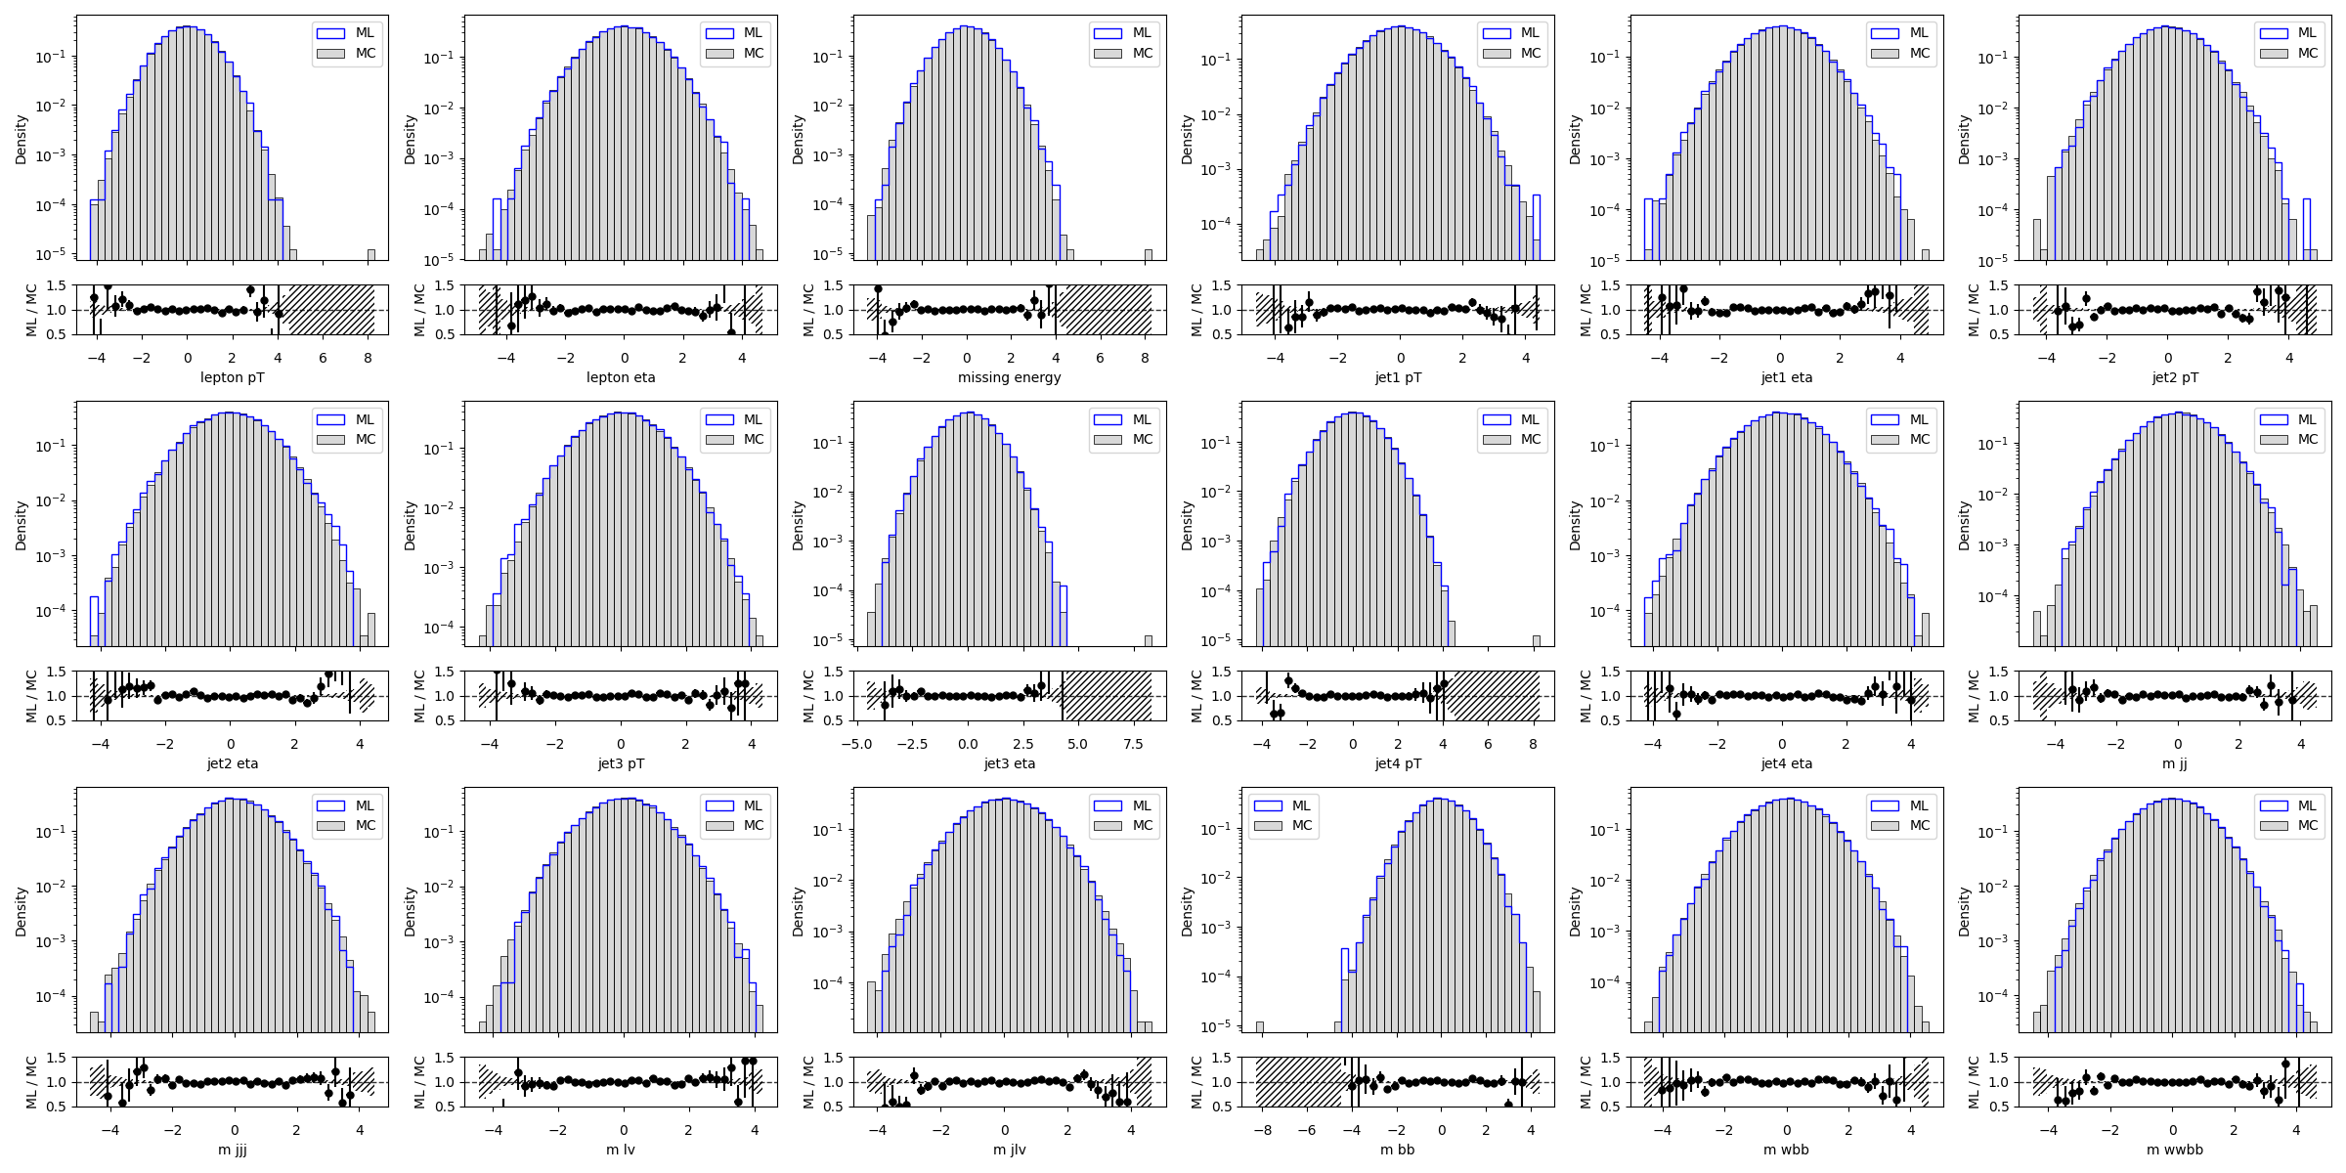
Training sampled snapshots for EDM xl
Epoch 192/196
Epoch 96/190
Epoch 0/190

